Slide 1
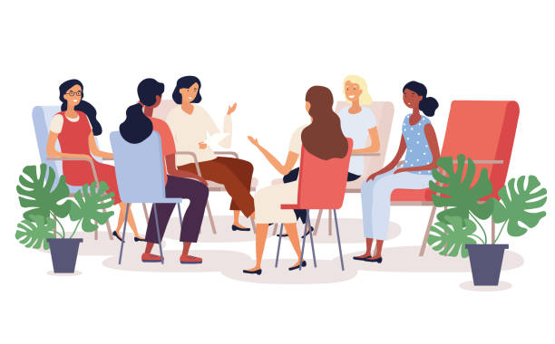
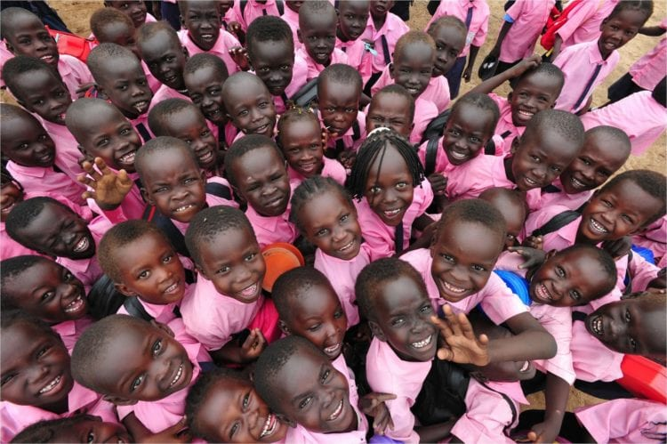

Group support psychotherapy(GSP); An opportunity of alcohol and drug abuse prevention among young people in Uganda
“WE SURVIVE AND THRIVE IN A GROUP MEMBERSHIP”
By Namazzi Christine Beepath

Slide 2
Alcohol and drug abuse problem among young people
Introduction
Alcohol and drug use problem is increasing Globally; more so among young people in Uganda. 60-70% of young people between age 15-27 years used elicit drugs (local News paper report 2019).
Regardless of age, young people have a right to proper mental health, which empowers them with the skills of making informed decisions, positively coping with stress, realizing potentiality, nurturing deep confiding relationships, and living a contributing life in the society.
Prevention and Treatment is scarce and foreign.

Slide 3
Group support psychotherapy; An opportunity of alcohol and drug abuse prevention
Young people are always deeply influenced by the people they interact with in their environment (Socialization is important)
Nothing makes life more meaningful than being surrounded by love and support. Having a community makes tough times manageable, challenges easier to overcome and daily life more enjoyable. Both our physical and mental health majorly benefit from time spent socializing. The support we give to and get from our circle of friends and family has the potential to change everything about our lives.

Slide 4

Group support psychotherapy; An opportunity of alcohol and drug abuse prevention
Development of culturally sensitive group support psychotherapy (GSP) is presented to be used as the first line strategy for alcohol and drug abuse prevention among young people in secondary school settings. Early observation of alcohol and drug abuse traits is encouraged; this will help to build prevention strategies, recruitment of same sex peers in group support psychotherapy to promote prevention.
This provides a safe haven to turn to incase of emotional instability and enlightenment on the different alternatives one can employ to solve problems and challenges other than using alcohol and drugs.
Young people can have a powerful impact on each other in their lives if they have access to the right resources and support services which is key in prevention of alcohol and drug abuse

Slide 5
Group support psychotherapy; An opportunity of alcohol and drug abuse prevention
Our major focus is on young people in secondary schools with the purpose to increase;
Awareness, socialization, observation, visualization, sensing, feeling and thus prevention of alcohol and drug abuse with its related effects in their setting.
This is expected later to result into positive outcomes such as;
Delayed onset of experimentation with drugs or alcohol,
Reduced cases of substance use disorders (alcohol or drugs) in schools.
Improved performance in school,
Positive coping mechanisms for Emotional and behavioral problems,
Improved self-esteem
Reduced risks of developing anxiety or depression.
Training in small livelihood activities for survival

Slide 6
Recommendations
Lessons Learnt
Group support psychotherapy is one of the effective strategy that can be used in prevention of alcohol and drug abuse among young people in Uganda.
Recommendations
For this innovation, young people will see the importance and appreciate the role of alcohol and drug prevention. Therefore, the training and making practice of GSP program will support them to prevent the level of alcohol and drug abuse which is becoming not only a national problem but a catastrophe destroying young people worldwide .
With all of this put into consideration, it’s quite evident that CSP has got a huge impact in prevention and only leaves us with one question “would you rather hear it from the talker or the walker????”

Slide 7
References
Nakimuli - Mpungu E., Wamala, K, Okello, J., Alderman, S., Odokonyero, R., Musisi, S., & Mojtabai, R. (2014). Developing a culturally sensitive group support intervention for depression among HIV infected and non- infected Ugandan adults: A qualitative study. Journal of affective disorders, 163, 10-17
Thank you for listening !!!!
Christine

